Slide 1


Powering the Financial Future: Intelligent Automation for Banks, Insurers, Funds and more
Use Cases for Banks, Insurers, Funds and Governmental Organizations
Dec. 17, 2025

Slide 2

Strategic Vision: Transforming Regulatory Burden into Strategic Advantage
To accelerate resilience by deploying a transformative, automated data platform for the entire financial ecosystem—including banks, insurers, funds, and more...
The Opportunity for Your Institution: A data technology solution that provides a single source of truth, enabling seamless oversight and fostering a competitive, innovative, and stable financial sector.
Key Outcomes:
Gain a 360° view of your risk and exposure.
Move from reactive compliance to proactive strategy with predictive insights.
Reduce compliance costs by over 50% and reallocate resources to growth.
Build a defensible, in-house data advantage.
We empower institutions to navigate uncertainty and regulatory complexity with AI-driven precision.

Slide 3
One Platform, Endless Possibilities: Powering the Entire Ecosystem
BBA Intelligent Data Platform
Banks 🏦
Insurers 🛡️
Funds 📊
Supervisors 👁️
Conglomerates ☂️
Governmental Organizations 🏛️

Slide 4
BBA Intelligent Data Platform
Solution | Key Features | Sector Applications
🎯 Strategic Command Center | AI-generated plans & competitive benchmarking | 🏦 Banks 🛡️ Insurers 📊 Funds
🛡️ Risk Advisor | Early warning systems & real-time monitoring | 🏦 Banks: ROE, NII Growth 🛡️ Insurers: Combined Ratio 📊 Funds: AUM Growth, IRR 👁️ Supervisors: Stability Index 🏛️ Governmental Organizations: Service delivery KPIS
⚖️ Compliance Co-Pilot | Automated reporting & audit trails | 🏦 Banks: LCR, NSFR, ICAAP 🛡️ Insurers: Solvency II, IFRS 17 📊 Funds: UCITS, AIF, Performance Reports 👁️ Supervisors: SupTech Dashboards

Slide 5
Agenda
Use Cases
Engagement Options & Approach
Key Deliverables & Benefits
Tech Stack

Slide 6
💬 Strategic Command Center | Guaranteed 3:1 ROI
Use case: Brand Positioning, Peer Analysis of Loan Loss Provisioning, Funding, Rate Ladder and AI Strategic Advisor
In today's digital world, a FI's reputation is its most valuable asset - and its most vulnerable. Traditional brand tracking is slow and expensive, leaving you reactive to negative trends on platforms like Google.
The Solution: Strategic Command Center – Strategic Advisory based on Publicly Available Data
Capability | Key Deliverables:
Our platform integrates with public data sources to provide a real-time, quantified view of your brand's health, market share, positioning, transforming subjective perception into actionable data. | Real-Time Sentiment Dashboard: Track positive, negative, and neutral mention volume across key platforms.
 | Competitive Benchmarking: Compare your ECL, balance sheet funding and rate ladder with peers. Identify your relative strengths and weaknesses.
 | Macroeconomic Scenarios: Forward looking base and stress cases
 | Strategic Goals Re-calibration: Increase Return on Equity (ROE) by 50-150 bps Grow Non-Interest Income by 5-15% Reduce Cost-to-Income Ratio by 5-10%
 | Strategic Advisory: Automatically flag emerging crises, complaint trends (e.g., "long wait times," "mobile app login issues"), and operational enhancements.

Slide 7
📊 Risk Advisor | Guaranteed 5:1 ROI
Investment Banks Use Case
Comprehensive Portfolio Data Origination
Key Deliverables & Strategic Advantages
Our automated platform consolidates data for a complete, multi-asset class view, providing a single source of truth for the entire portfolio.
  Digital Assets: One platform, every asset class: from traditional to digital.
  Fixed Income & Sukuks: Sovereign & Corporate Bonds, Sukuks
  Public Equities: Listed Equities & ETFs
  Real Assets: Direct & Fund-based Real Estate Investments
  Structured Products: ABS, MBS, and other bespoke instruments
  Alternatives: Private Equity, Venture Capital, Hedge Funds
Single Source of Truth: A unified view of risk and performance across both liquid and complex illiquid assets, eliminating data silos.
Enhanced Transparency & Drill-Through: Automated, granular exposure tracking for opaque assets like Structured Products and Real Estate.
Data-Driven Capital Allocation & Pricing: Accurate, timely data on Sukuk yields, public equity performance, and private equity valuations.
Streamlined Regulatory Reporting: Efficient, auditable data lineage for IFRS 9 ECL, LCR/NSFR, and ICAAP calculations directly from the portfolio data hub.

Slide 8
🏦 Compliance Co-Pilot | Guaranteed 7:1 ROI
Commercial Banks Use Case
Data Origination: Automated Data Lineage
Data Wall: Centralized Data Foundation
Daily
Intraday Liquidity
Monthly
Asset Liability Management
Monthly
Liquidity Coverage Ratio
Net Cumulative Cash Flow
BCAR (Basel Capital Adequacy Ratio)
Market Risk
Credit Risk
NSFR (Net Stable Funding Ratio) /Model Risk
ECL (Expected Credit Loss) /IFRS 9
ICAAP: Internal Capital Adequacy Process
Quarterly
Yearly
ICAAP
Stress Testing
Dashboard

Slide 9
Compliance Co-Pilot | National Talent Empowerment & Efficiency
Supporting Localization Initiatives with Intelligent Automation
The Challenge:
Regulatory Complexity: GCC banks face expanding local employment regulations, CBB/CMA/SAMA compliance, and reporting.
Resource Drain: Skilled finance talent is often consumed by manual, repetitive compliance tasks instead of strategic local economic initiatives.
Talent Deployment Gap: Over 40% of finance professionals’ time is spent on data wrangling and manual report preparation, limiting their strategic impact.
What We Automate | Local Talent Impact
Data Aggregation & Lineage Automated data pulls from core banking, GL, and risk systems. | Frees up to 2-3 hours/day per analyst from manual data collection—time now spent on analysis and strategy.
Regulatory Reporting Auto-generates: • BCAR (Basel III) • LCR / NSFR /NCCF • IFRS 9 ECL Calculations • SAMA/CMA Monthly Dashboards | Reduces report preparation from weeks to hours, enabling staff to focus on interpretation and strategic advisory for national goals.
Stress Testing & ICAAP Automated scenario runs and capital adequacy documentation. | Transforms a monthly/quarterly, all-hands exercise into a continuous monitoring process managed by a lean team.

Slide 10
👁️ Regulatory/SupTech Use Case:
Automated Supervisory Data Submission
Our differentiators are not just technical, but deeply rooted in regulatory expertise and local commitment, ensuring a seamless and effective implementation.
Proven Regulatory DNA & Superior Capability
Capability | BBA | Typical Competitors
Pre-built Regulatory Mappings | ✔ Full Automation of OSFI/CBB-style returns (Basel II/III/IV, FRTB) | Manual configuration & costly customization
Central Bank-Specific ML Models | 12+ Pre-built Models (e.g., ECL, Systemic Risk, LCR) | Limited templates; build on-site for extra fee
Bahraini Talent & Investment | ~70% Local talent ratio; formalizing membership with Bahrain FinTech Bay/AFS | <30% Local presence; limited ecosystem investment
Deep Regional & Islamic Finance Expertise
Proven CBB Framework Knowledge: Ensure 100% regulatory compliance with solutions built by the architects of Bahrain's own frameworks
Seamlessly manage your dual-sharia and conventional books with native AAOIFI/IFSB compliance
You own your data and your future: We build your team's capability, not just our footprint

Slide 11
Agenda
Use Cases
Engagement Options & Approach
Key Deliverables & Benefits
Tech Stack

Slide 12
BBA Reporting Automation – Choose Your Path
Tailored solutions to meet your data governance and infrastructure preferences.
Option 1: Fully Managed Service
Hands-off, end-to-end solution
Option 2: Advisory & Enablement Service
Your infrastructure, our expertise
Ideal for clients who want a complete, hands-off solution to transform raw data into actionable insights without the operational overhead.
Data Ingestion: We accept your raw data in any format.
Data Management: Our team handles all data cleaning, transformation, and manages full data lineage for accuracy and trust.
Model Integration: Data is ingested into either your existing models or BBA's proven analytical frameworks.
Delivery: We produce finalized reports and update dashboards on a scheduled basis.
Hosting: This service is delivered securely on BBA's cloud infrastructure, ensuring high performance, security, and scalability.
Designed for clients who require data to remain on their internal cloud for privacy, compliance, or governance reasons but want to leverage our best practices.
Advisory & Blueprinting: We provide the strategy, playbooks, and architecture design for your automated reporting pipeline.
Implementation Guidance: Our experts guide your internal team through the setup process for data cleaning, modeling, and dashboard creation.
Tooling & Templates: You receive BBA's proprietary tools, scripts, and report templates.
Hosting: The entire solution is built and runs on your company's private cloud. BBA does not take possession of your data.
Benefit: Maximize efficiency and focus on insights, and strategy
Benefit: Maintain full data control while accelerating your internal capabilities.
12

Slide 13
Implementation Phases
PHASE 1:
DISCOVER
PHASE 2:
DESIGN
PHASE 3:
IMPLEMENT
TARGET Setting
Set stretch efficiency targets
Size functional opportunities (People, Process, Systems)
Identify key improvement levers
Iterative Process
Detail & Validate Opportunities
Develop and evaluate solution options
Create detailed technical and process designs
Build out robust business cases
Plan for Implementation
Benefits Realization
Define project charters and secure approval
Develop resource, cost, and timing plans
Establish governance and accountabilities
Implement automation solutions
Manage change and user training
Track benefits and optimize performance

Slide 14
Agenda
Use Cases
Engagement Options & Approach
Key Deliverables & Benefits
Tech Stack

Slide 15
Reporting Automation Project - Key Outcomes & Strategic Benefits
Quantifiable Benefits & Key Performance Indicators (KPIs)
Efficiency & Process Gains | Data Governance & Control | Risk, Compliance & Reputation
Duplicate Processes Identified: 15 Processes Rationalized: 12 Automation Created: 1 core reports FTEs Redeployed: 3.0 (to higher-value analysis) Reporting Cycle Time Reduced: ~65% | Data Silos Removed: 4 Critical Data Elements (CDE) Defined: 125 Data Lineage Documented & Improved: 100% of automated reports Data Quality Issues Resolved: ~40 | Compliance Challenges Remediated: 8 Delayed Submissions Incidents: 0 Manual Error Reduction: ~90% Reputation & Stakeholder Trust: Enhanced
Cycle Time Reduction: ⬇️ ~700% | Manual Error Reduction: ⬇️ 90% | On-Time Submission: ✅ 100% | FTE Capacity Freed Up: 🚀 3.0 FTE
15

Slide 16
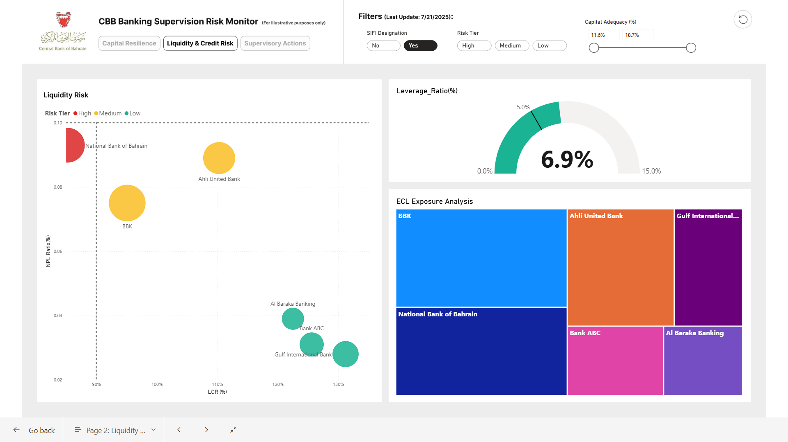
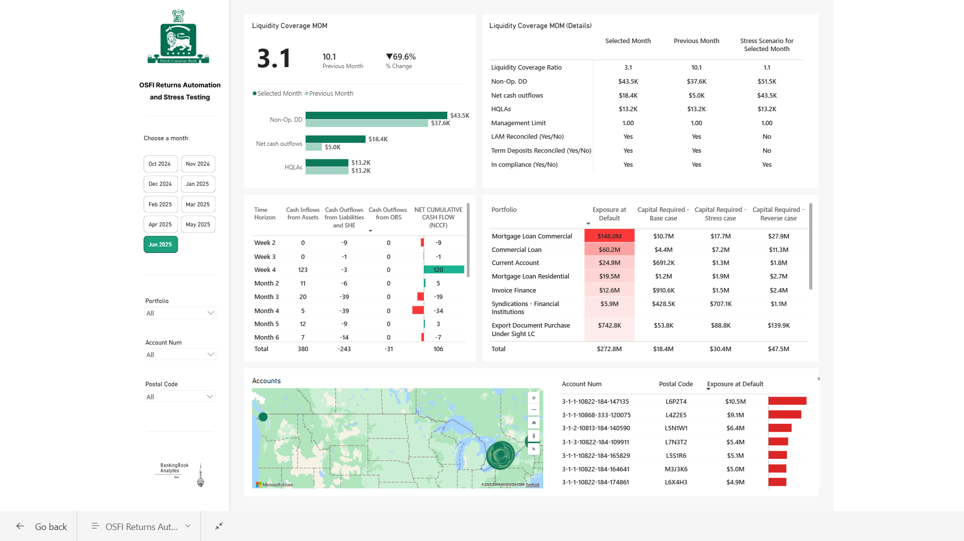
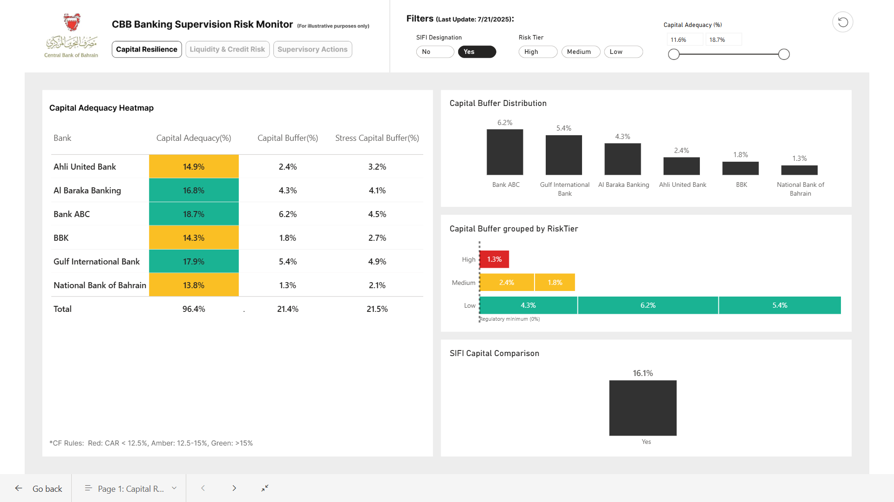
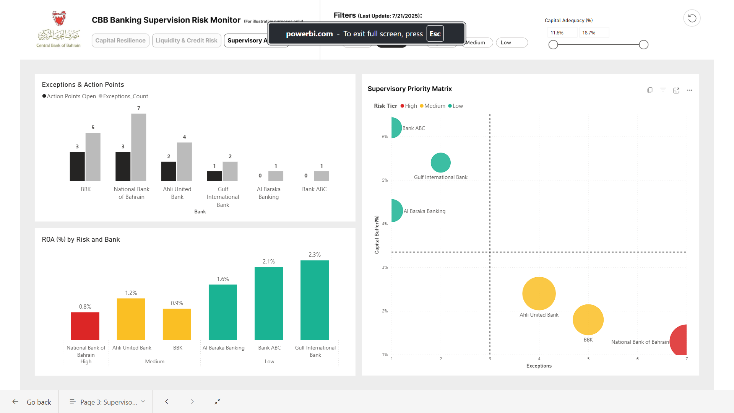
Intelligence Hub
Cut reporting-related OPEX by over half

Slide 17
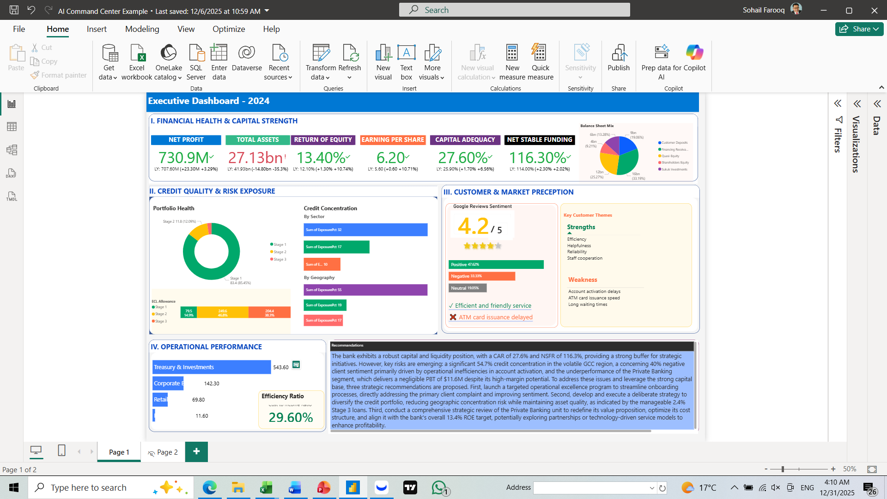
Strategic Command Centre with Integrated Work Flow – An Example

Slide 18


The BBA Solution: Transform Reporting from a Burden to a Strategic Advantage
Achieve up to 700x faster reporting for specific returns, like LCR (as shown in the case study)
Data Governance
Data Ingestions
Modelling
Reporting
Dashboarding
Sources
Validation/
Reconciliation
Machine Learning Models
Regulatory Report
Visualization
Quality checks
Lineage checks
~ in 10 minutes/report
End-to-end automation, AI-powered data cleaning, guaranteed accuracy, dynamic dashboards.
Streamlined Reporting Cycles
Reduce manual effort and deliver insights faster with automated workflows. Custom Dashboards & Templates
Tailor reports and visualizations for stakeholders. Seamless Compliance & Collaboration
Pre-built templates for regulators, boards, and clients.
📊

Slide 19
Case Study: From 5-Day Fire Drill to 10-Minute Click: A Blueprint for Your Success
Client Profile: Mid-Sized Commercial Bank
Challenge: Inefficient, error-prone Liquidity Coverage Ratio (LCR) reporting
Description or the Problem: Manual LCR Reporting Took 5+ Days with High Risk of Errors
Background : The bank was required to submit a monthly Liquidity Coverage Ratio (LCR) report to regulators, requiring data from multiple siloed systems:
Treasury Systems (HQLA – High-Quality Liquid Assets)
Core Banking (deposits, withdrawals, net cash flows)
SIT: Term Deposits
Excel (manual adjustments)
Pain Points
Disparate Data Sources – Data was scattered across 5+ systems with inconsistent formats.
Manual Reconciliation – Analysts spent 2-3 days just fixing mismatched entries.
Excel Overload – Critical calculations were done in spreadsheets, leading to version control issues and errors.
Regulatory Risk – Late or inaccurate submissions could trigger penalties.
The Old Process (5+ Days)
The Solution: BBA AI-Powered LCR Automation
BBA deployed its proprietary AI engine to automate LCR reporting end-to-end:
Automated Data Aggregation
    Integrated with Treasury, Core Banking, Risk, and Deposit Systems via JSON APIs.
    Standardized data fields (e.g., "HQLA" vs. "Liquid Assets") using machine learning.
AI-Driven Cleaning, Validation & Reconciliation
    Flagged outliers (e.g., missing data, hard coded) for review.
    Auto-corrected common errors (e.g., misclassified deposits).
Dynamic Regulatory Compliance
    Applied Basel III LCR rules in real time.
    Generated data filtration system for common accounts and currencies, developed audit trails for compliance teams.
Self-Checking Reports
    Compared results against historical trends to detect anomalies.
    Produced regulator-ready reports (PDF, Excel, OSFI templates) in one click.
Results: From 5 Days to 10 Minutes
Business Impact
  ✅ 700x Faster Reporting – From 5x3 FTE days to under 10 minutes
  ✅ Eliminated Manual Errors – AI reduced reconciliation mistakes by 100%
  ✅ Improved Regulatory Confidence – Automated audit trails ensured compliance
  ✅ Freed Up Analysts – Team shifted from data wrangling to strategic liquidity planning
Ready to automate your regulatory reporting? Contact BBA Today
Metric | Before | After
Time to Generate LCR | 5+ days | <10 minutes
Manual Effort | 3 FTEs | Fully automated
Error Rate | High (manual) | Near-zero (AI validation + Parallel run)
Regulatory Compliance | Risky (late submissions) | Always on time
Day | Activity | Issues
1-2 | Data extraction & cleaning | Data extraction & cleaning
3 | Manual reconciliation | Mismatched trade dates, incorrect classifications
4 | Regulatory adjustments in Excel | Formula errors, overwritten files
5+ | Risk team review & corrections | Last-minute recalculations needed
Result: A slow, high-risk process that delayed decision-making and increased compliance expo

Slide 20
Agenda
Use Cases
Engagement Options & Approach
Key Deliverables & Benefits
Tech Stack

Slide 21
We use secure, enterprise-grade technology (Microsoft Azure) and our own proprietary AI to do the heavy lifting. You get the insights, not the complexity.
Client raw data sourcing
Data automation layer
Data intelligence layer
Business actions
Data cleaning
Client analytics engine
BBA analytics engine
Strategy alignment
Data automation layer
BBA ML models
Data transformation
Automated alerts
Intelligence layer
Automated reporting
Data reconciliation
Action points tracking
Business actions
Dynamic dashboards
Data validation/audit trail
Performance management
Continuous improvement
Data storage

Slide 22
Ready to Transform Your Regulatory Reporting?
Discovery Call
Opportunity Assessment
Define a Path Forward
A 30-minute session to identify your top 3 reporting inefficiencies.
Receive a customized, high-level estimate of potential time and cost savings for your firm.
Receive a customized, high-level estimate of potential time and cost savings for your firm.

Slide 23

Let’s Build Your Sustainable Future
Next Steps:
  1. Schedule a 30-minute discovery call
  2. Receive a high-level opportunity assessment
  3. Define a path forward (Managed or Advisory)
+973 3745 0606
contact@bbafintech.com
bbafintech.com
BankingBook Analytics (BBA FinTech)

